Slide 1



Computational Engineering Laboratory Case Study 2 Heat Transfer through Tapered Fins
Nisarg Solanki 20BME100
Harsh Raval 20BME102
Dev Ghiya 20BME108

Slide 2



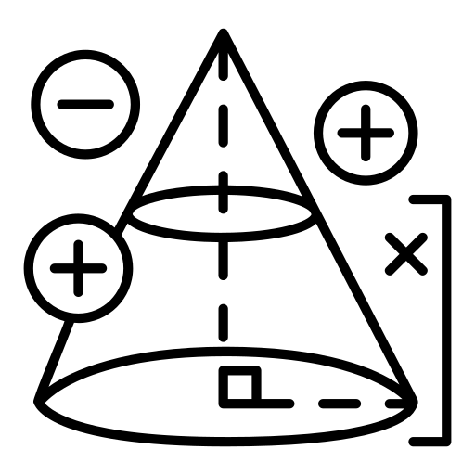



Methodology
Tool Used: Partial Differential Toolbox in MATLAB
Create a thermal model and define it to be in steady state
Import the Geometry in the model
Define the material properties of the fin
Define boundary conditions
Show the result with post processing

Slide 3




Dependency
The convective co-efficient of the geometry depends on
Velocity of the flowing fluid
Ambient temperature of fluid
Area exposed to the fluid (up stream or down stream)

Slide 4



MATLAB Code
clear all;
clc;
close all;
% Assuming the model to be steady state
tmodel = createpde('thermal', 'steadystate');
% Importing CAD file
importGeometry(tmodel, 'Tapered Fin.stl');
% Naming the faces of the CAD model
pdegplot(tmodel, 'FaceLabels', 'on', 'FaceAlpha', 0.5);
% Generating Mesh of the model
msh = generateMesh(tmodel, 'Hmax', 1);
%Material Properties
kappa = 20000; % in W/m/K
% Defining thermalconductivity
thermalProperties(tmodel, 'ThermalConductivity', kappa);
% Defining Boundary Condition
thermalBC(tmodel, 'face', 1, 'Temperature', 300);
thermalBC(tmodel, 'face', 6, 'ConvectionCoefficient', 50, 'AmbientTemperature', 25);
thermalBC(tmodel, 'face', 3, 'ConvectionCoefficient', 30, 'AmbientTemperature', 25);
thermalBC(tmodel, 'face', [4 5], 'ConvectionCoefficient', 40, 'AmbientTemperature', 25);
% Solving the Model for given condition
Rt=solve(tmodel);
% Ploting the model with different countour
pdeplot3D(tmodel, 'ColorMapData', Rt.Temperature)
xlabel('X-Axis')
xlabel('Y-Axis')
xlabel('Z-Axis')
title('Heat Transfer through Tapered Fins')

Slide 5
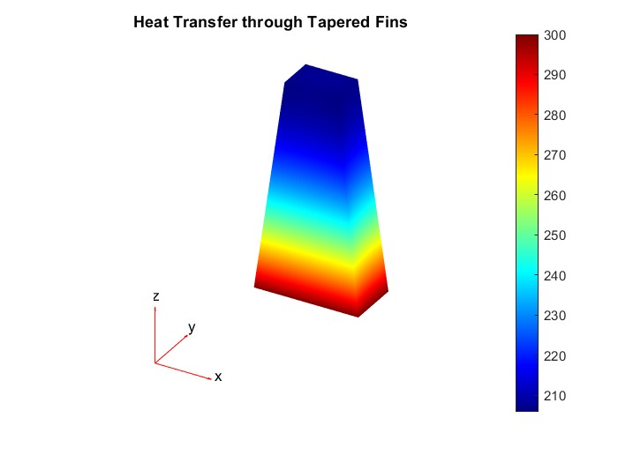
Result
Heat Transfer through conduction by Tapered Fins

